Slide 1

Tunneling through the Hill: Multi-way Intersection for Version-Space Algebras in Program Synthesis
Guanlin Chen*, Ruyi Ji*, Shuhao Zhang*, Yingfei Xiong
School of Computer Science
Peking University

Slide 2
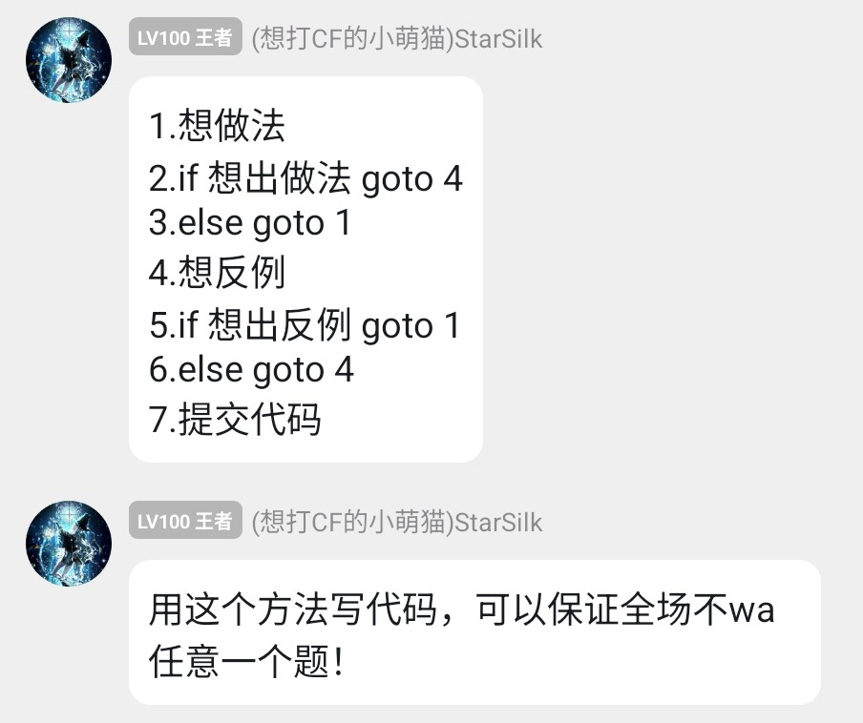
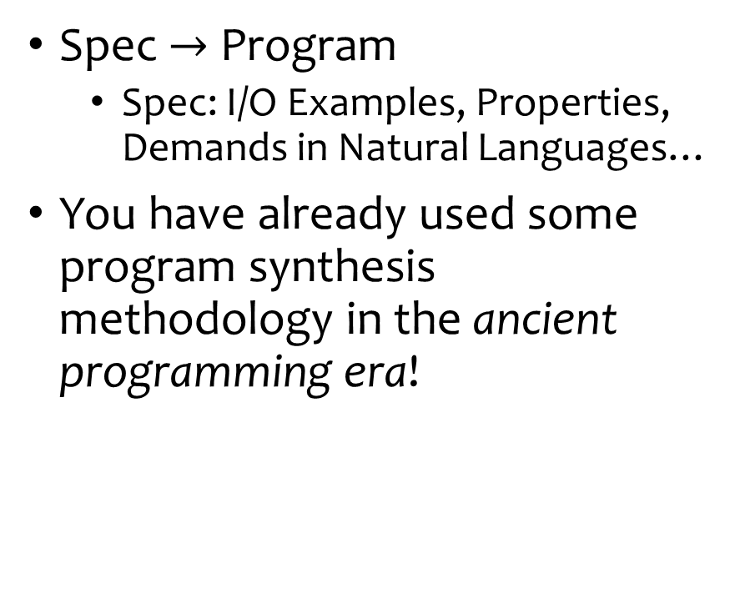
Background: Program Synthesis
Spec $→$ Program
Spec: I/O Examples, Properties, Demands in Natural Languages…
You have already used some program synthesis methodology in the ancient programming era!

Slide 3
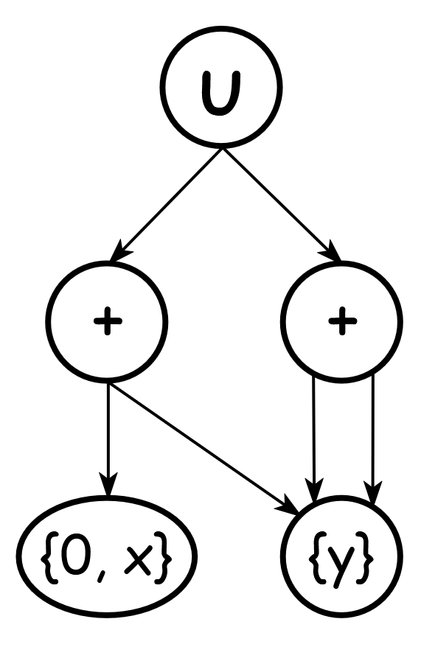



Version-Space Algebra
Use a graph-like structure to represent program spaces
A node represents a program space with same outputs
$$\{0+y, x+y,y+y\}$$
$$\{0+y, x+y\}$$
$$\{y+y\}$$

Slide 4
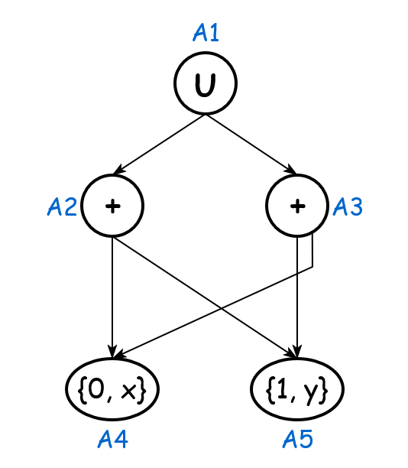
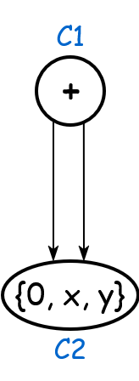
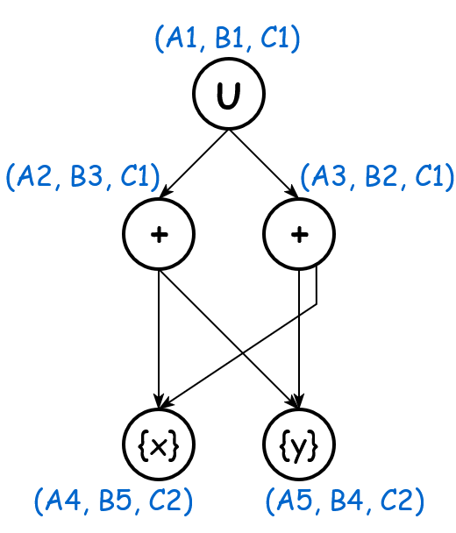
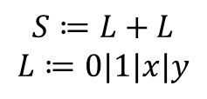
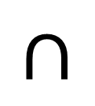
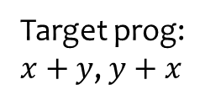
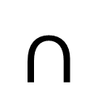




VSA-based Program Synthesis
Our focus!
Examples
VSA builder
Single-example VSAs
Semantics
$$S≔L+L$$
$$L≔0|1|x|y$$
VSA intersection
Final VSA
Program
$$∩$$
$$∩$$
$$=$$
Target prog:
$x+y$, $y+x$
$$\left\langle x=0, y=1\right\rangle ↦1$$
$$\left\langle x=1, y=0\right\rangle ↦1$$
$$\left\langle x=0, y=0\right\rangle ↦0$$

Slide 5
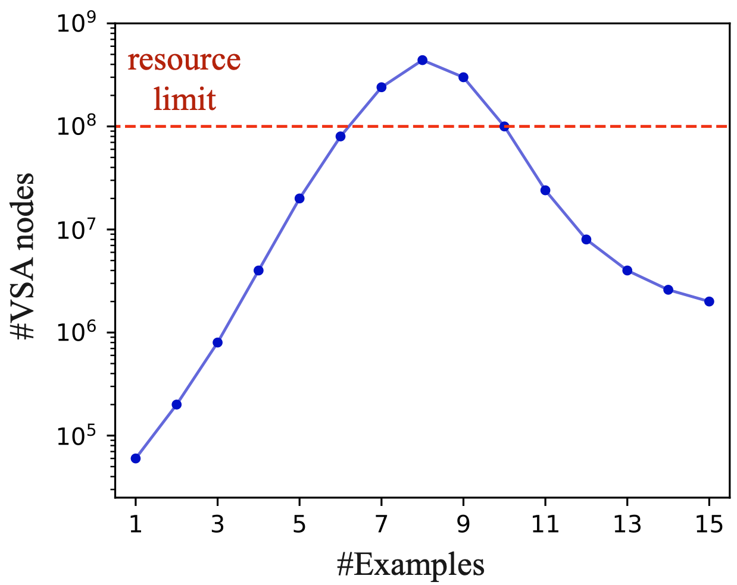
Iterative Intersection
Avoid reaching here!💥
Iterative VSA intersection: add single-example VSAs one by one
Key observation in the iterative VSA intersection process: a hill-like curve for the size of the intersected VSAs
VSA more complicated: the equivalent program space split (size ↑)
Program space smaller: fewer programs satisfy all examples (size ↓)

Slide 6
Our Contribution
Multi-way Intersection (for multiple VSAs intersection)
Bottom-up Intersection (to improve intersection efficiency)
An efficient tool called Mole

Slide 7
Multi-way Intersection
Multi-way intersection: merge multiple VSAs (not just 2) into one VSA directly
Avoid a huge intermediate VSA😄
Possible?
Yes!

Slide 8
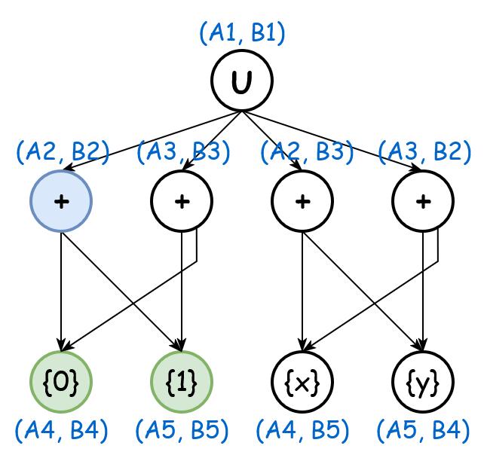
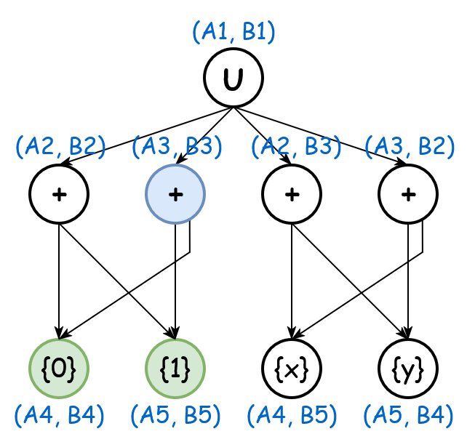
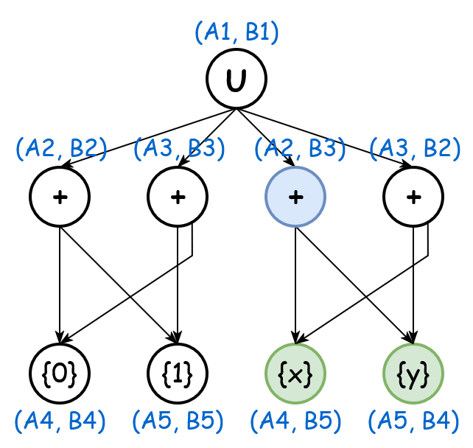
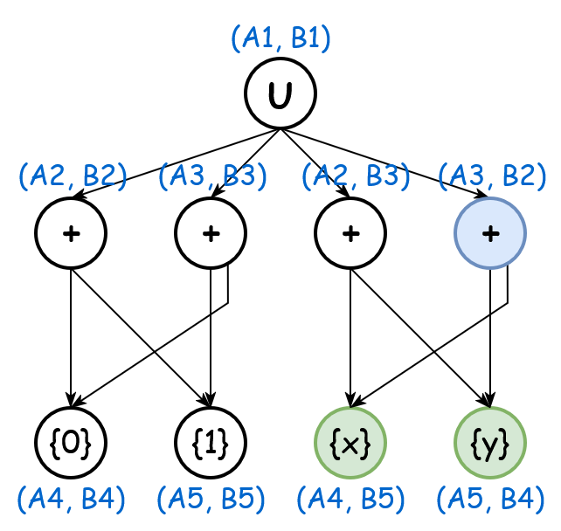
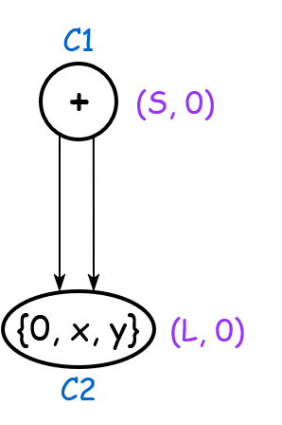
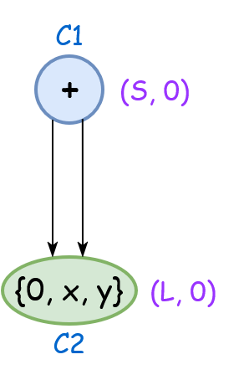
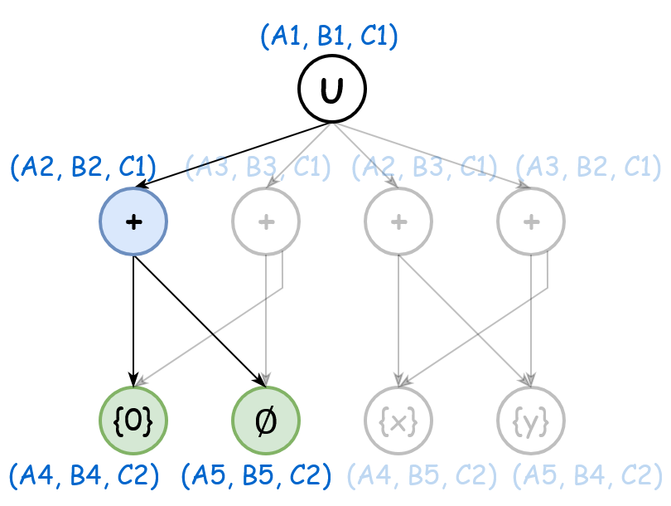
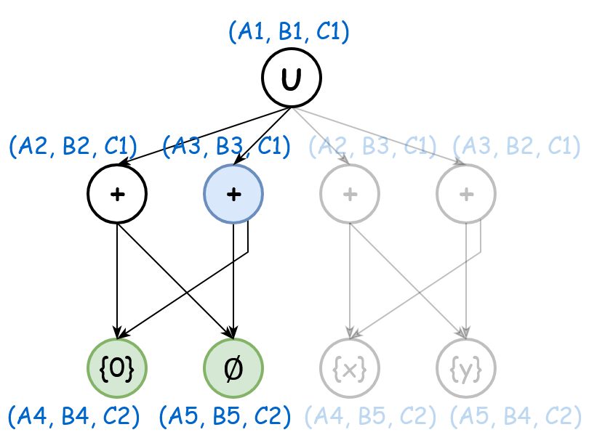
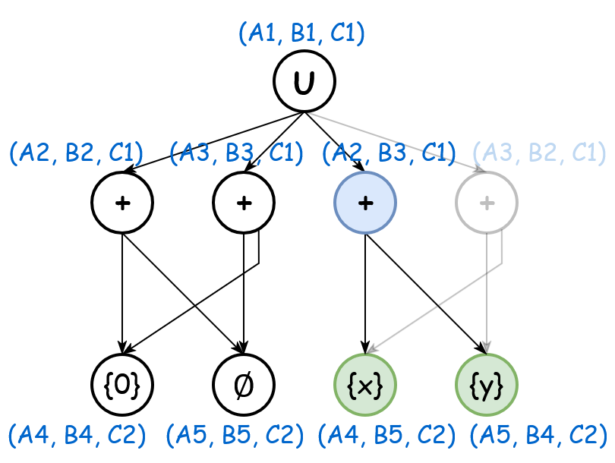
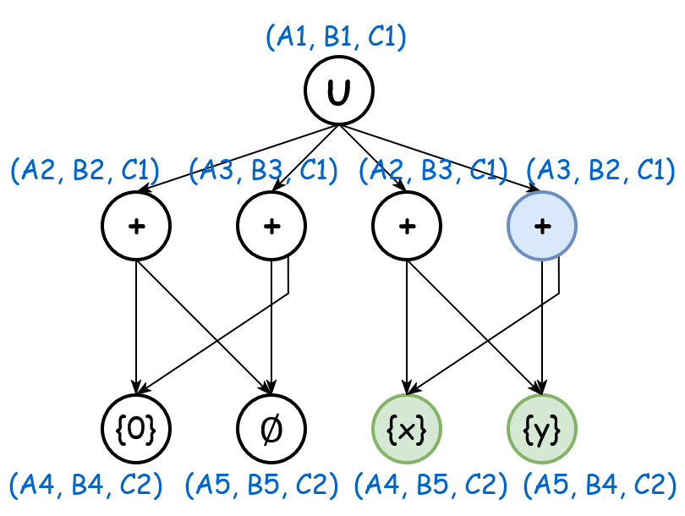
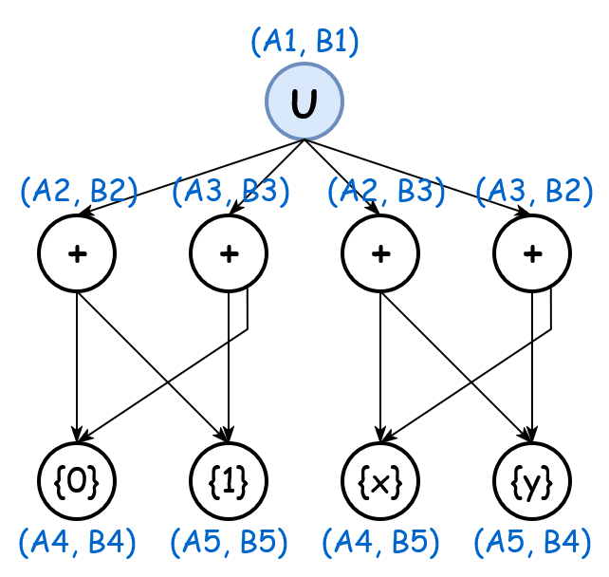
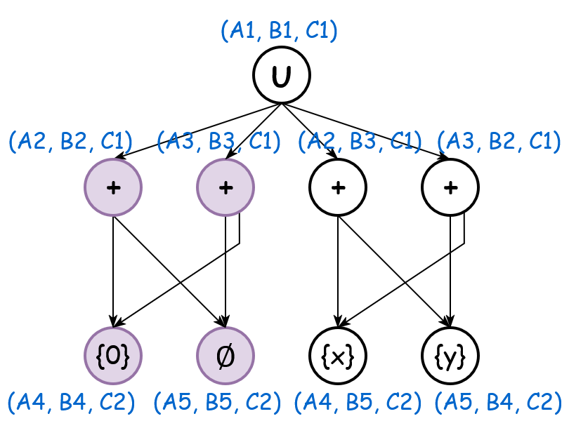
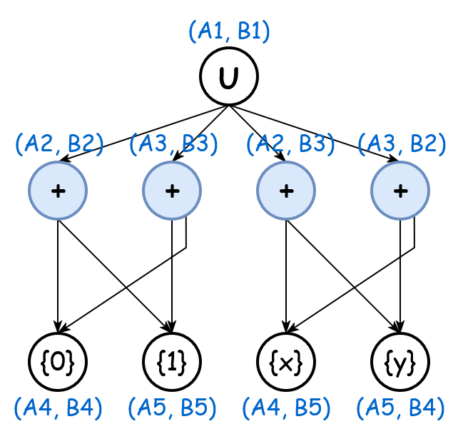
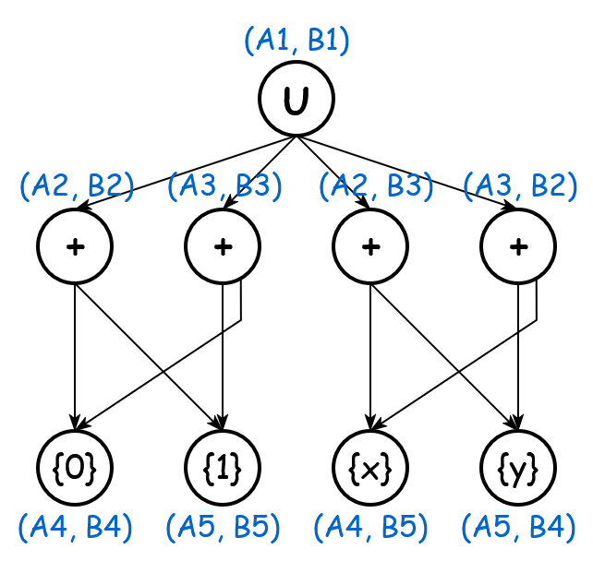
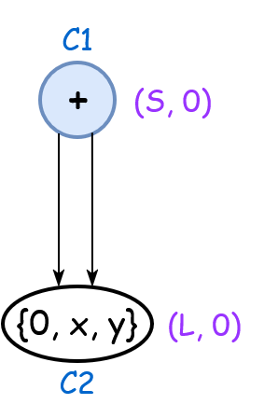
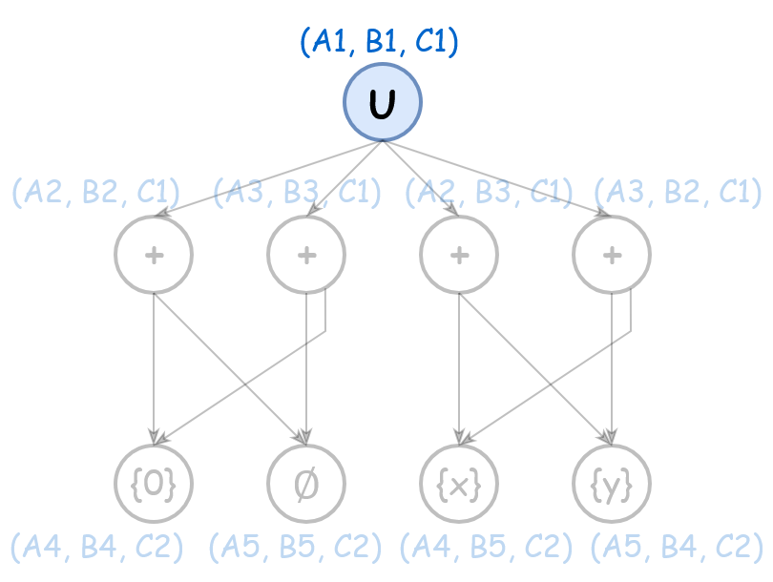


Top-down Intersection
Intersection starts from root
Many unnecessary nodes representing no program may be constructed → low efficiency
❌Not suitable for multi-way intersection
$$∩$$
$$=$$

Slide 9

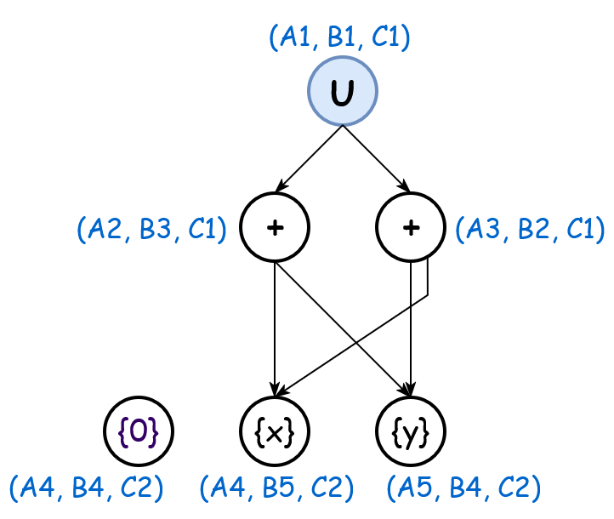
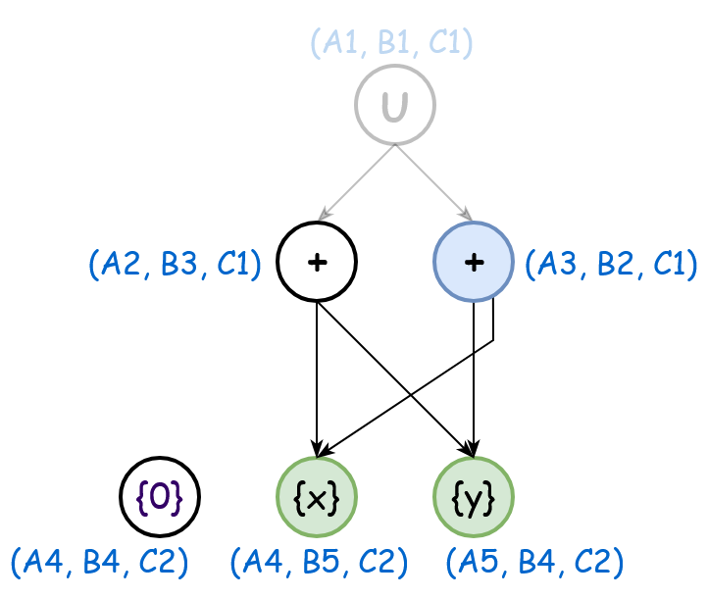
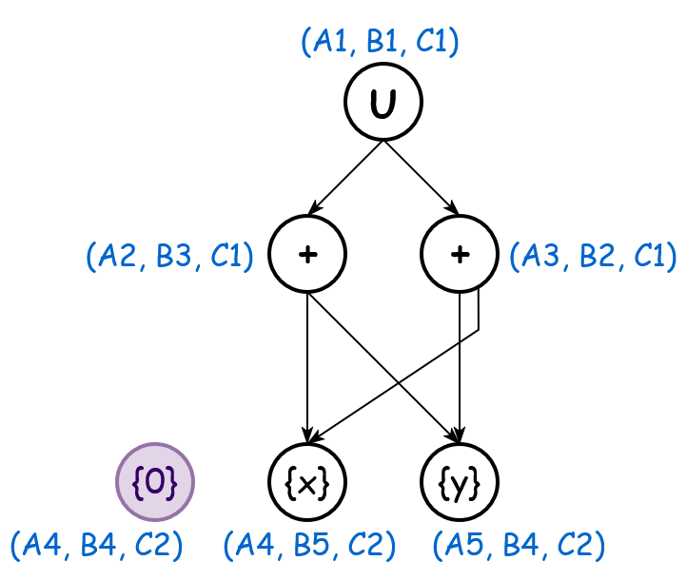

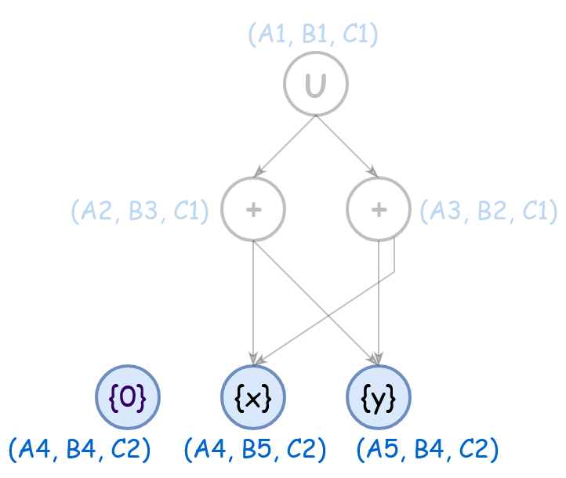
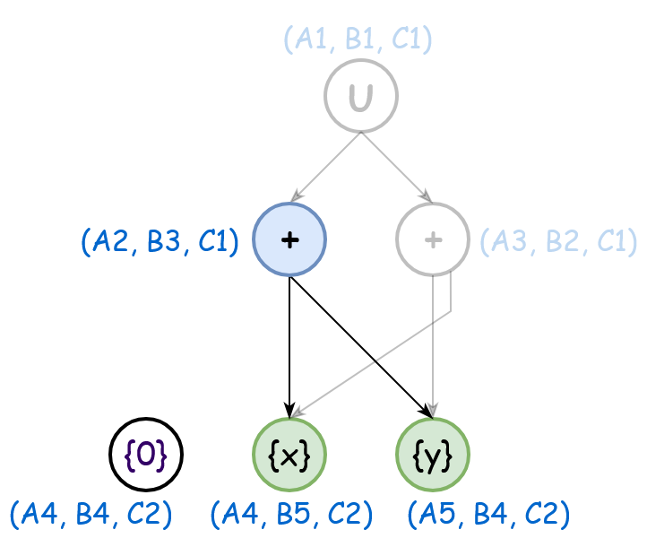
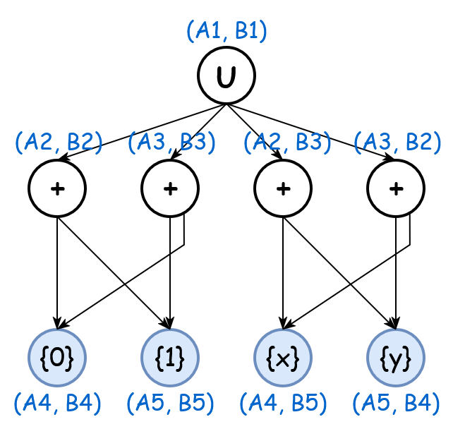
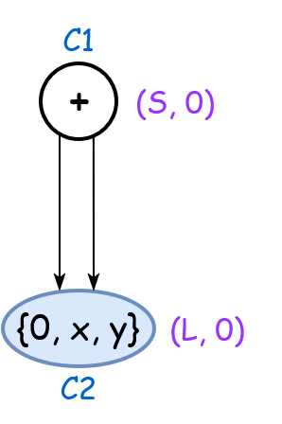


Bottom-up Intersection
Intersection starts from leaf
No unnecessary nodes representing no program are constructed
$$∩$$
$$=$$

Slide 10
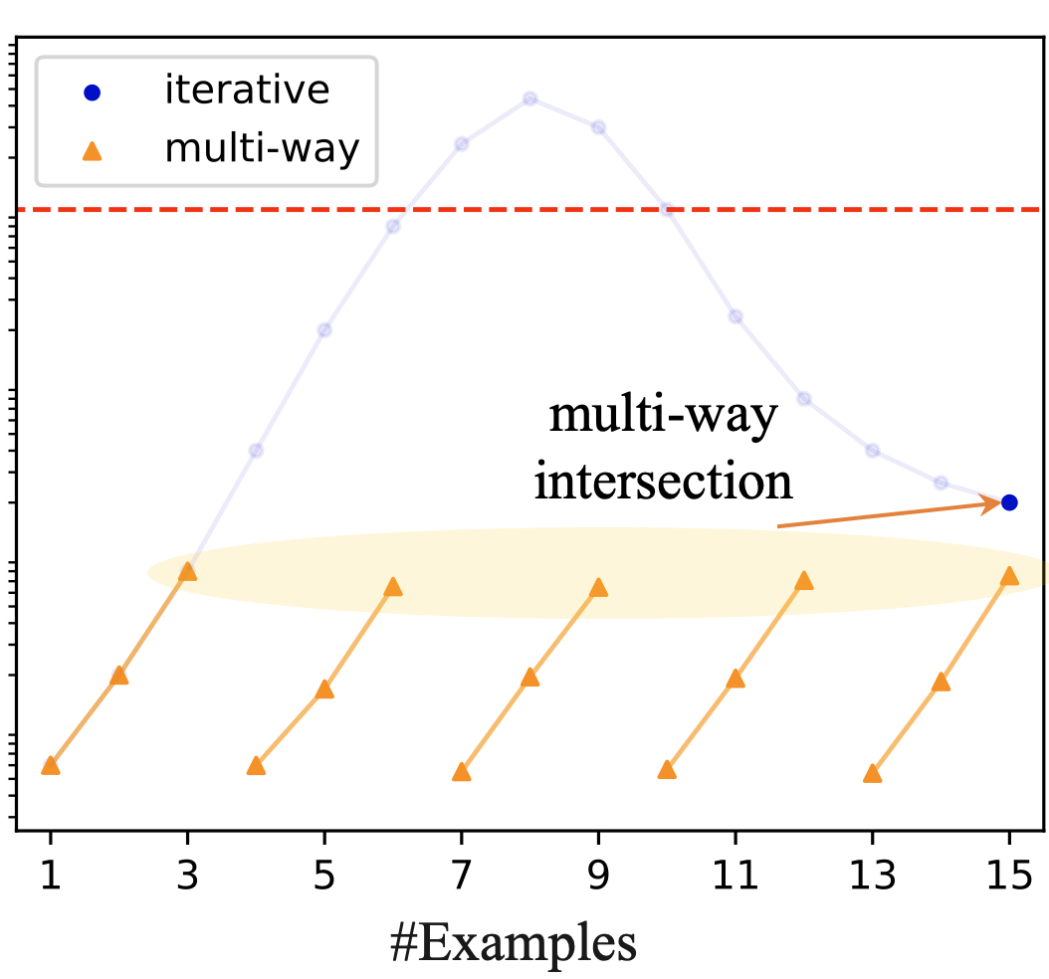
Grouping Strategy
Huge overhead
When too many VSAs
Iterative intersection in the group

Slide 11
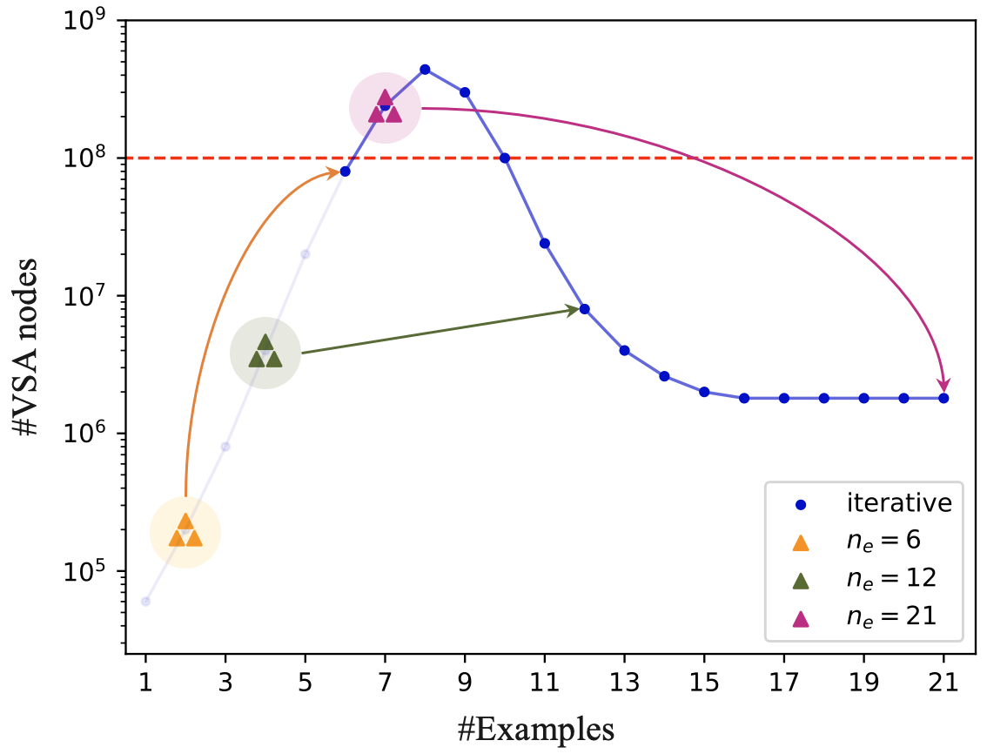
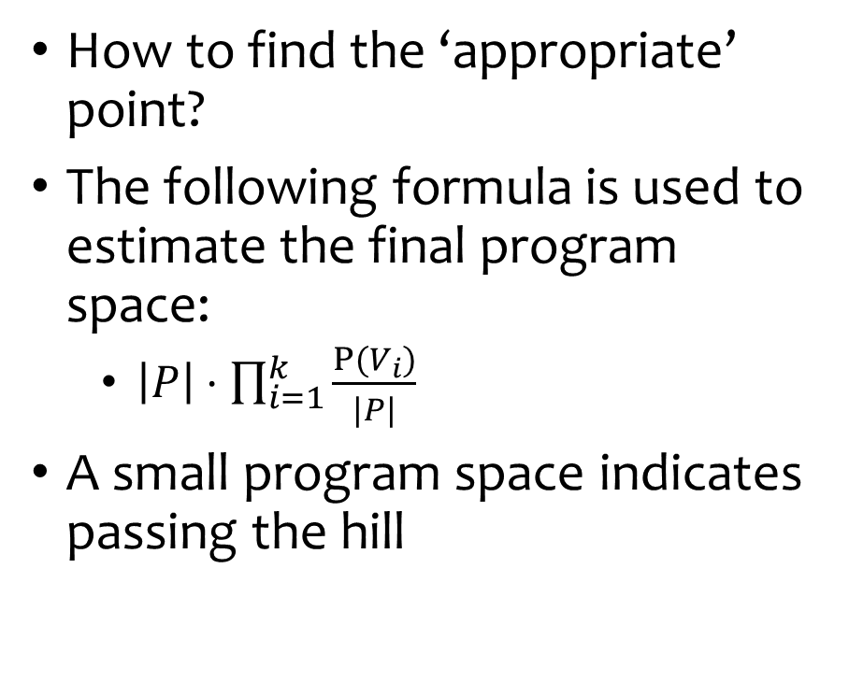
Grouping Strategy (Cont.)
How to find the ‘appropriate’ point?
The following formula is used to estimate the final program space:
$\left|P\right|⋅\prod_{i=1}^{k}{\frac{P(V_{i})}{|P|}}$
A small program space indicates passing the hill
Too many: intermediate VSAs reach the peak💥
Appropriate: Tunnel through the hill with smallest intermediate VSAs😀
Too few: failed to tunnel through the hill😢

Slide 12
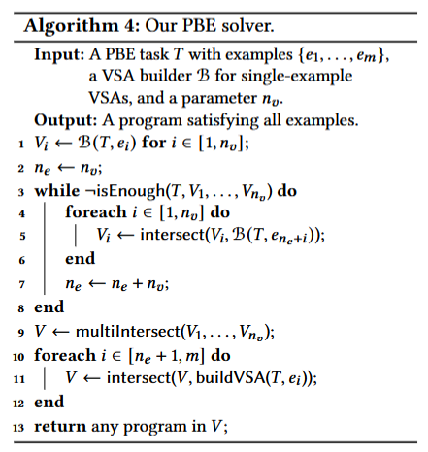
Implementation
Phase 1: multi-way intersection with grouping
Phase 2: iterative intersection

Slide 13
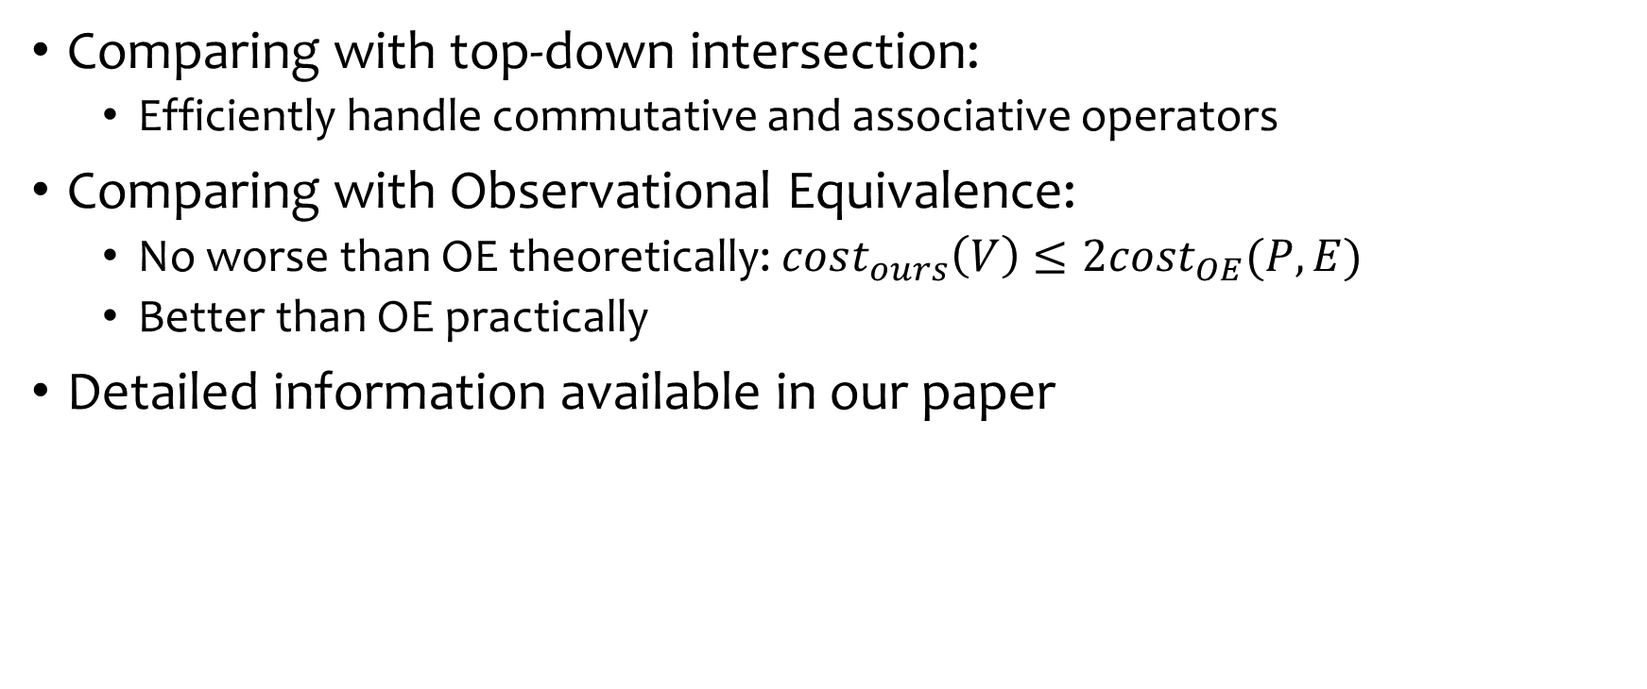
Properties
Comparing with top-down intersection:
Efficiently handle commutative and associative operators
Comparing with Observational Equivalence:
No worse than OE theoretically: $cost_{ours}\left(V\right)≤2cost_{OE}(P,E)$
Better than OE practically
Detailed information available in our paper

Slide 14
Evaluation – Overview
Speed-up VSA Intersection
Speed-up Specialized VSA-based Solver
Ablation Study of Each Component (See our paper)

Slide 15
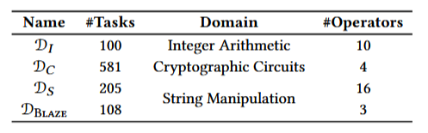
Evaluation – Speed-up VSA Intersection
Solvers:
Mole_{FTA} (Ours): multi-way, bottom-up VSA intersection with grouping
RawVSA [Polozov and Gulwani 2015]: iterative, top-down VSA intersection
OE [Udupa et al. 2013]: Observational Equivalence
Datasets: 3 domains from SyGuS-Comp [Alur et al. 2019]
For next exp.

Slide 16
Evaluation – Speed-up VSA Intersection (Cont.)
Findings: Time cost and #VSA nodes reduced
Significantly better performance on challenging tasks

Slide 17
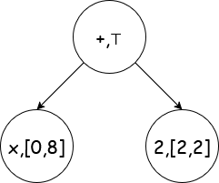
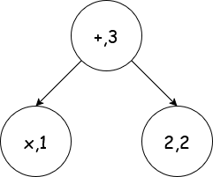
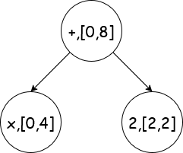
Evaluation – Speed-up Specialized VSA-based Solver
Blaze [Wang et al. 2018] is a specialized VSA-based solver based on abstraction refinement
We implement Mole_{Blaze} to optimize the intersection process
Original AFTA
AST annotated with counter-example
Refined AFTA

Slide 18
Evaluation – Speed-up Specialized VSA-based Solver (Cont.)
Findings: Mole can accelerate specialized VSA-based solver

Slide 19
Summary
Observation: Iterative intersection constructs a large intermediate VSA, making it inefficient.
Solution: Propose multi-way intersection to tunnel through the scale hill.
Observation: Top-down intersection performs poorly in the multi-way intersection process.
Solution: Propose bottom-up intersection to avoid constructing invalid nodes.
Thank you!

